Slide 1
L.E.D
«Leading the way to improve energy efficiency in public schools and propagate the use of Renewable Energy Sources»

Slide 2
L.E.D
2. ENERGY POLICIES
«Leading the way to improve energy efficiency in public schools and propagate the use of renewable energy sources»

Slide 3
Contents
01
Historical review
02
The Energy Policy of the European Union
03
The Energy Policy of Greece

Slide 4
Historical review (1)
Starting point of the unifying effort
Coordination effort in the energy sector
1951: Signing of the ECSC Treaty in Paris by the founding members of the EEC (France, Germany, Italy, the Netherlands, Belgium and Luxembourg),
Creating an internal market for the free movement of coal and steel,
1957: the Treaty on European Economic Community (EEC) and the Treaty on the European Atomic Energy Community (EAEC or EURATOM) are signed in Rome;
1973: Oil crisis - rising oil prices.
1985: European energy policy enters the EU agenda,
In the early 1980s, increased gas use and a dramatic increase in nuclear power generation,
Trying to create a real internal energy market,
Maastricht Single European Act and Treaty which provides for action in the field of energy.
1974-1985
1950-1974
1985-2009
Collective treatment of challenges
Inability of the six founding states of the Community to act collectively,
Establishment of the International Energy Agency (IEA),
Energy shortages created by the oil crisis,
States pursued differentiated policies.

Slide 5
Historical review (2)
EU Objectives (1985) in the energy sector:
Creation and efficient operation of an internal energy market
Security of energy stocks in Europe
Protection and respect for the environment from energy production and consumption.
2009 – Σήμερα
1985-2009
Treaty of Lisbon (2007)
a special chapter on energy is introduced
Union policy aims to:
Ensure the European Union's energy supply,
Ensure the functioning of the internal energy market,
Promote energy efficiency and energy saving, and the development of new and Renewable Energy Sources,
In the development of energy infrastructure and the interconnection of the Trans-European Networks.

Slide 6
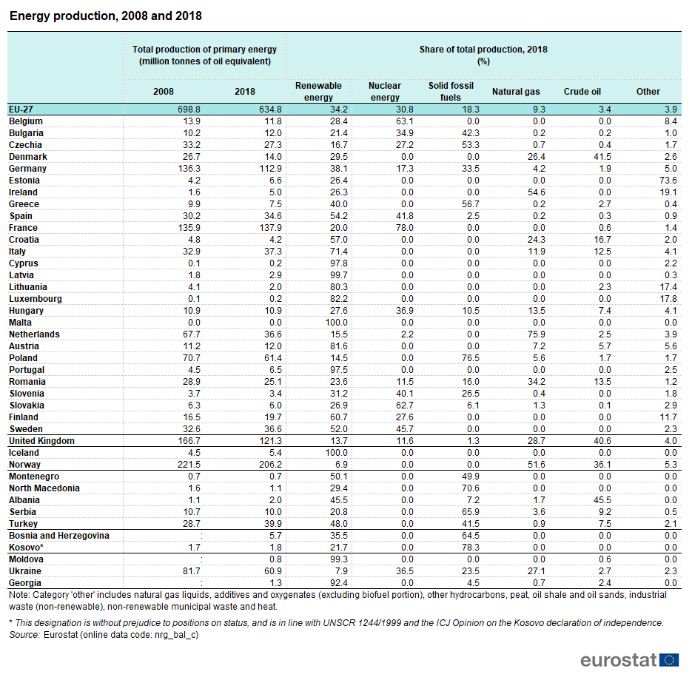
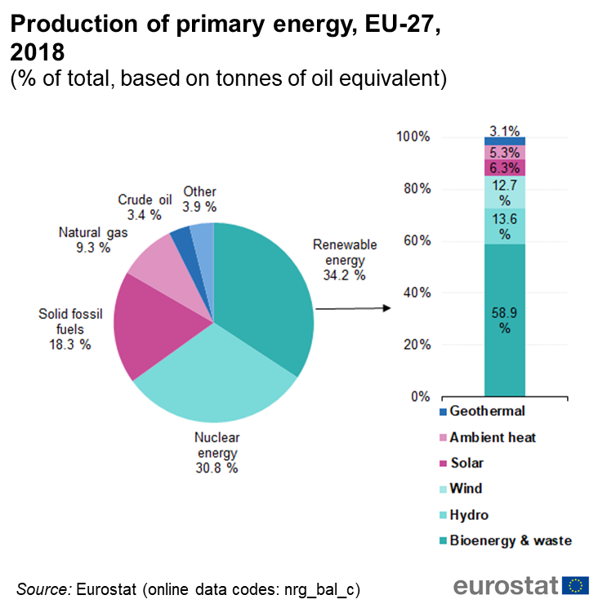
Current situation E.U (1)
Production of primary energy, EU-27, 2018
Renewable Energy Sources - 34.2%
Nuclear Energy - 30.8%
Solid Fossil Fuels - 18.3%
Natural Gas - 9.3%
Crude Oil - 3.4%
Energy Production Levels EU-27
France (21,7%)
Germany (17,8%)
Poland(9,7%)
Italy (5,9%)

Slide 7
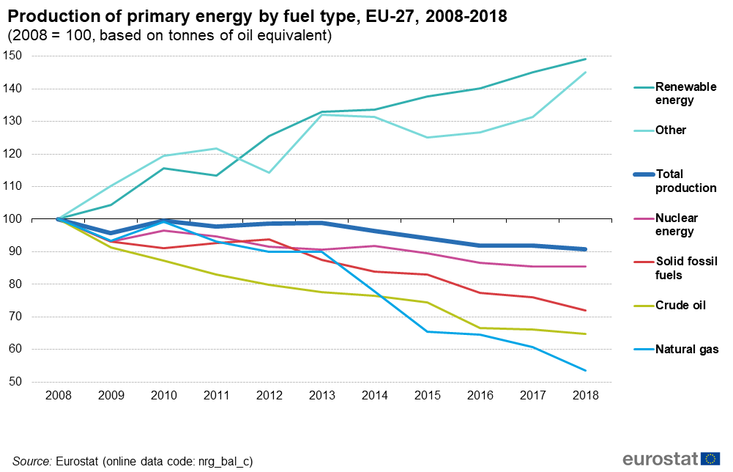
Current situation E.U (2)
Production of primary energy (by fuel type), ΕΕ-27, 2008-2018
EU primary RES production increased by more than all other types of energy, by 49%,
The largest decreases were recorded in:
natural gas (-46.4%),
crude oil (-35.3%) and
solid fossil fuels (-27.9%).
The smallest decrease (-14.4%) was recorded for nuclear energy.

Slide 8
Current situation E.U (3)
The EU's dependence on energy imports
Oil and gas in particular — are the basis for concerns about security of energy supply.
Lack of production versus consumption - the EU's growing dependence on energy imports from third countries.
Το 2018 (58,2 %) της ακαθάριστης διαθέσιμης ενέργειας της ΕΕ καλύφθηκε από εισαγόμενες πηγές.
In 2018 (58.2%) of the EU gross available energy was covered by imported sources.
2018 the highest production levels in the EU France (21.7%) followed by Germany (17.8%), Poland (9.7%) and Italy with 5.9%.
14 of the 27 EU Member States recorded an increase in primary energy production in the period 2008-2018.

Slide 9
Future EU strategies/forecasts
EU targets for 2030, Planning 2050, New Green Deal - European Commission
2015- EU Framework Strategy on Climate Change and Energy to ensure safe, sustainable, competitive and economical energy for its consumers.
It requires a radical transformation of Europe's energy system.
2016 Clean Energy Package for all Europeans - transition of the European economy to clean energy through the creation of new jobs, business models and economic sectors.
The main objectives of the Package are:
the priority in energy efficiency
the achievement of a world leader in energy from RES and
the provision of a fair deal for consumers
long-term plan 2018 for a prosperous, modern, competitive and climate-neutral economy by 2050
A clean planet for all.
EU targets for 2030
Climate and energy targets by 2030:
reduction of greenhouse gas emissions by at least 40% compared to 1990 levels,
increase the share of RES to at least 32% of final gross energy consumption and
energy efficiency improvement of at least 32.5%.

Slide 10
The European Green Deal and the Just Transition Mechanism
The European Green Deal
Provides an action plan for:
enhancing the efficient use of resources by moving to a clean, cyclical economy
biodiversity restoration and pollution reduction
predicts a reduction of pollutant emissions by at least 50% to 55% compared to 1990 levels.
The Just Transition Mechanism
The EU will also provide financial support and technical assistance to those most affected by the transition to a green economy.
Investments - 100 billion euros for the period 2021-2027 in the areas most affected.
A key tool to ensure that the transition to a climate-neutral economy is fair
The investment plan of the European Green Agreement is based on three pillars:
Financing: Mobilization of sustainable investments amounting to at least € 1 trillion. over the next decade.
Facilitation: Providing incentives for the release and reorientation of public and private investments.
Practical support: The Commission will provide support to public authorities and project implementers in the planning, design and execution of sustainable projects.

Slide 11
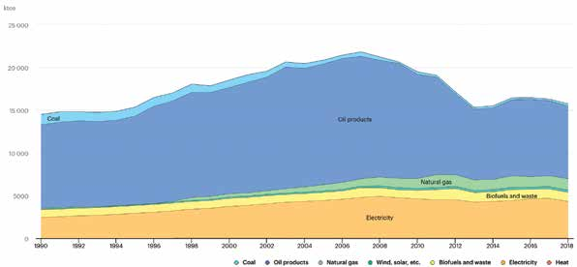
The Energy Policy of Greece (1)
Current Energy Situation in Greece
Final energy consumption for the period 1990-2018:
The largest percentage corresponds to the consumption of petroleum products (54.2%), electricity (27%), the use of RES (8.7%), natural gas (8.3%) and lignite (1.8%), to follow.
In the last decade, consumption of fossil fuels (lignite, petroleum and natural gas) has decreased by 36% in the end-use sectors. was replaced by gas consumption, the use of RES and electricity.

Slide 12
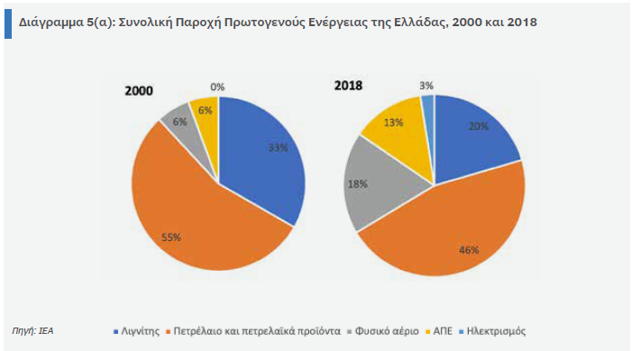
The Energy Policy of Greece (2)
Current Energy Situation in Greece
Total supply of primary energy in Greece:
petroleum products 46%
lignite 20%
natural gas 18%
RES with 13%

Slide 13
The Energy Policy of Greece (3)
Major Reforms in the Greek energy market
arising from European legislation to harmonize the institutional and legislative framework of the energy market.
1.
No electricity supplier will hold more than 50% of the retail market from 1st of January 2020.
2.
Full liberalization of the gas market by 2018, with the separation of marketing activities from those of the management of city networks.
3.
Increasing the share of Renewable Energy Sources.

Slide 14
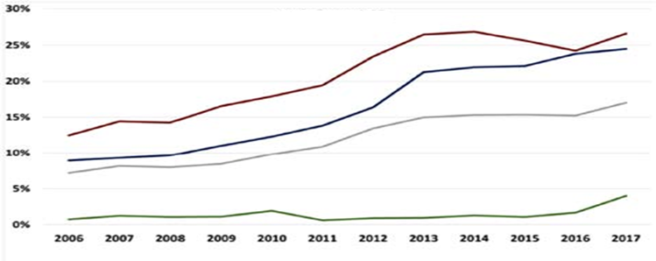
Renewable Energy Sources in Greece
Current Energy Situation in Greece
Total and Special Shares of RES Participation in the Energy System of Greece:
the contribution of RES showed a significant increase for the period 2006-2017.
their total contribution in 2017 as a share in gross final energy consumption amounted to 17%
the share of RES in gross domestic electricity consumption in 2017 amounted to 24.5% showing an impressive increase compared to 2006.
Gross electricity consumption
Final energy consumption for heating and cooling
Final energy consumption in transport
Gross final energy consumption

Slide 15
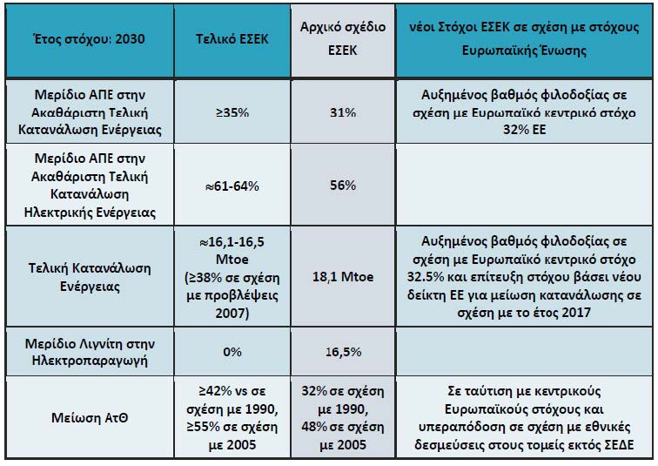
National Energy Policy Objectives of Greece 2030
Current Energy Situation in Greece
Specific targets have been set for EU Member States under the Common European Energy Policy.
Important for Greece is the issue of climate change, which has arisen from the long-term use of lignite.
Greece's energy policy, which is in line with that of the EU, is reflected in the updated National Plan for Energy and Climate (ESEK-2019),

Slide 16
National Energy Policy Objectives of Greece 2030
The main objectives of the national energy planning are:
Creating an integrated model of sustainable development in all sectors of the economy,
Combining energy sector development with environmental protection with decisive measures to combat climate change,
Selection of energy policies with the optimal cost-benefit ratio for the energy transition,
Waste management and utilization with modern technologies of circular economy,
Transformation of Greece into an energy hub with a strong contribution to EU energy security and security of supply,
Strategic diversification of energy imports, along with the modernization and development of energy infrastructure and the lifting of the energy isolation of the islands,
Creating an attractive investment environment to support the energy transition, with an emphasis on innovation and new technologies,
Maximizing the use of Community resources and mechanisms,
Turning to extroversion and innovation to achieve growth and create new jobs.

Slide 17
Greece's Long-Term Energy Strategy for 2050
Climate and Energy Sector Strategy:
It was created in addition to the ESEK, which is the basis of strategic planning, through which specific policy measures are exercised in the energy and climate sectors.
The decade 2030-2040 will play a crucial role in the selection and implementation of technological solutions as well as the observance of successful policies that will enhance the achievement of the EU targets by 2050.
It presents some scenarios regarding the evolution of the energy system and the consumption patterns in the final sectors with the long-term goal of the transition to a climate-neutral economy by 2050.
These scenarios will be the framework through which the selection and design of policies that will lead to the transformation of the model of energy production and consumption.

Slide 18
THANK YOU!
«Leading the way to improve energy efficiency in public schools and propagate the use of Renewable Energy Sources»

